Slide 1
WbLS work/analysis
8/22/2019

Slide 2
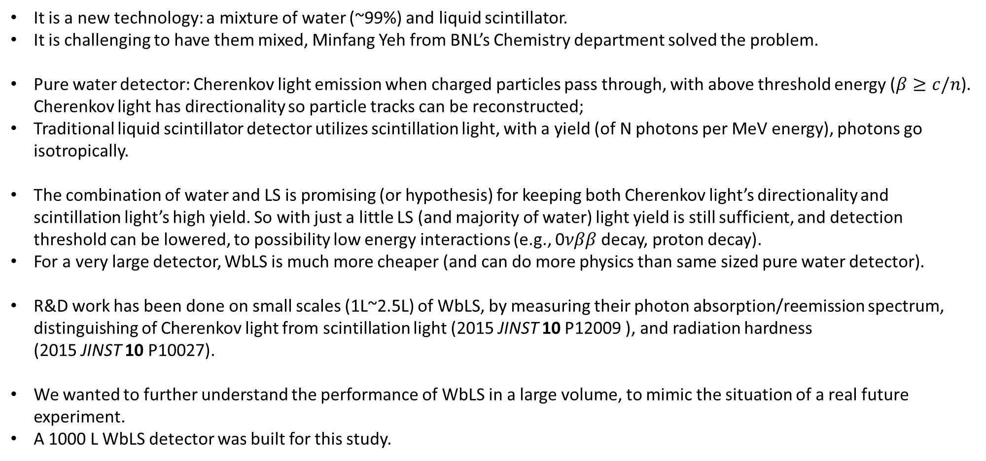
About WBLS: water-based liquid scintillator
It is a new technology: a mixture of water (~99%) and liquid scintillator.
It is challenging to have them mixed, Minfang Yeh from BNL’s Chemistry department solved the problem.
Pure water detector: Cherenkov light emission when charged particles pass through, with above threshold energy ($β≥c/n$). Cherenkov light has directionality so particle tracks can be reconstructed;
Traditional liquid scintillator detector utilizes scintillation light, with a yield (of N photons per MeV energy), photons go isotropically.
The combination of water and LS is promising (or hypothesis) for keeping both Cherenkov light’s directionality and scintillation light’s high yield. So with just a little LS (and majority of water) light yield is still sufficient, and detection threshold can be lowered, to possibility low energy interactions (e.g., 0$νββ$ decay, proton decay).
For a very large detector, WbLS is much more cheaper (and can do more physics than same sized pure water detector).
R&D work has been done on small scales (1L~2.5L) of WbLS, by measuring their photon absorption/reemission spectrum, distinguishing of Cherenkov light from scintillation light (2015 JINST 10 P12009 ), and radiation hardness (2015 JINST 10 P10027).
We wanted to further understand the performance of WbLS in a large volume, to mimic the situation of a real future experiment.
A 1000 L WbLS detector was built for this study.

Slide 3
1000 L WbLS –
Initial goals :
Understand light production in the large volume: how much fraction is Cherenkov light?
Understand light propagation: how photons get attenuated, absorbed/reemitted etc?
Method:
Build the detector and collect cosmic ray data
Build a simulation model to predict results
Compare data and simulation, determine the parameters for the simulation model
Apply the parameters, and scale up the detector size in simulation, explore the feasibility for physics.

Slide 4
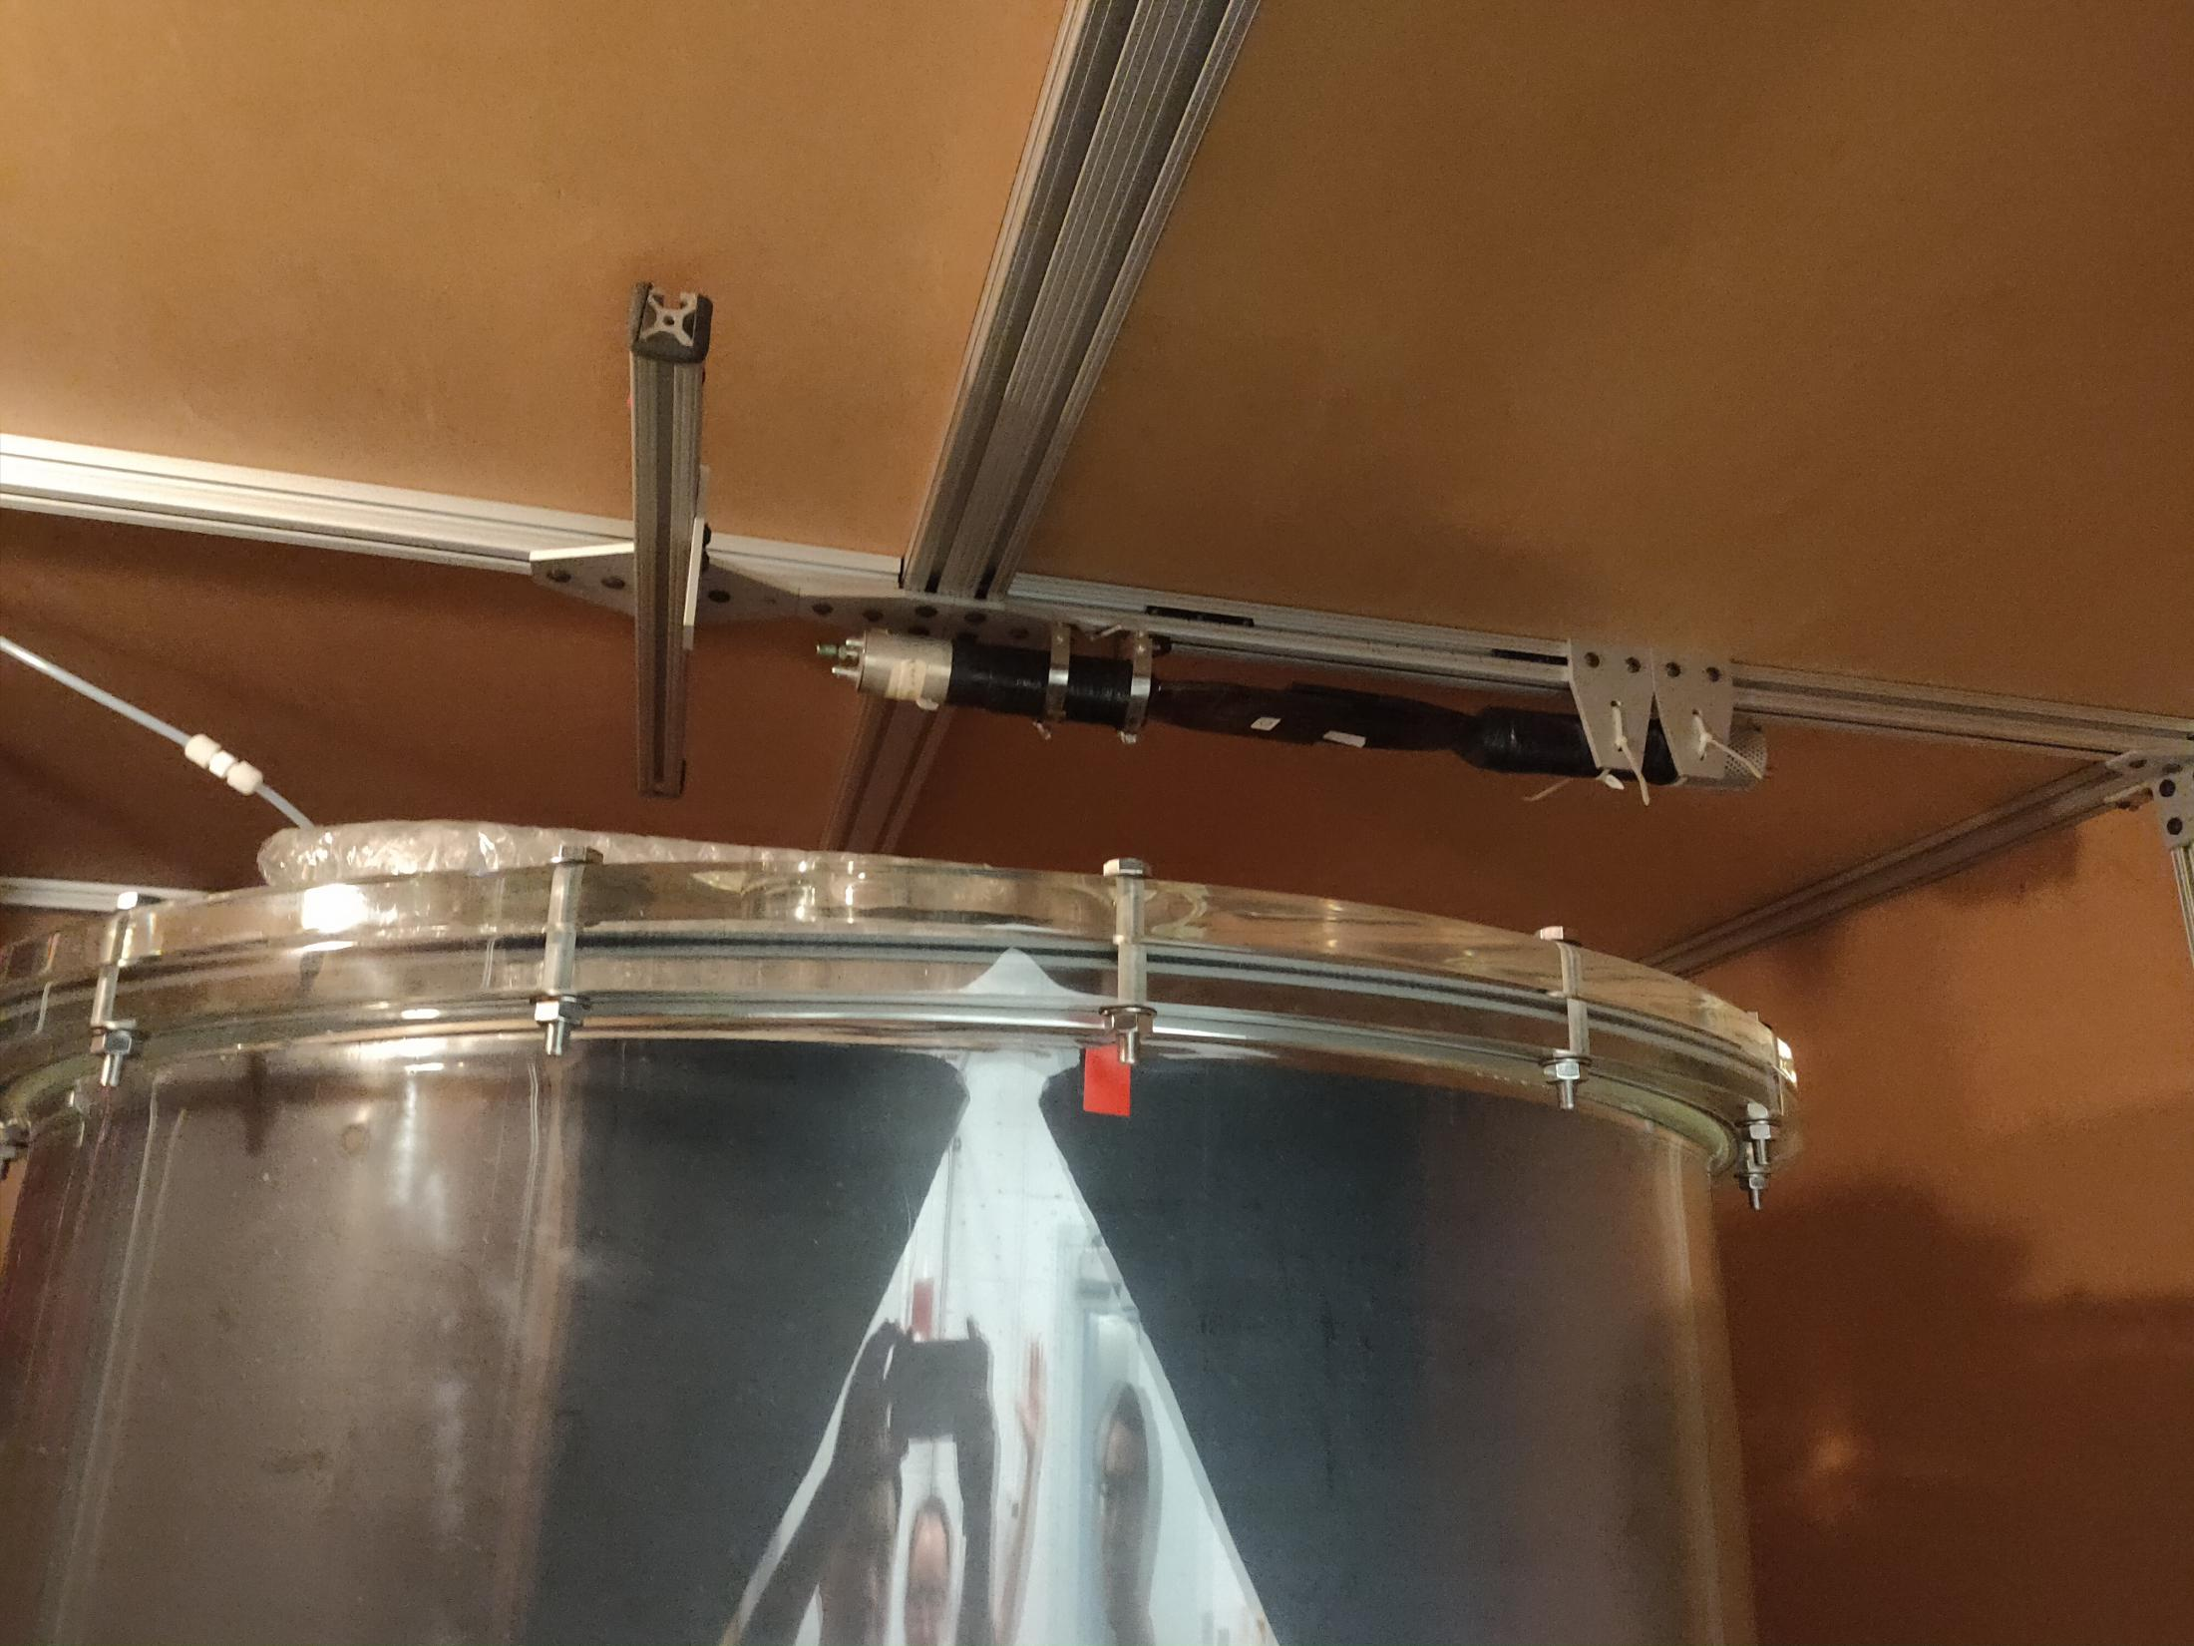
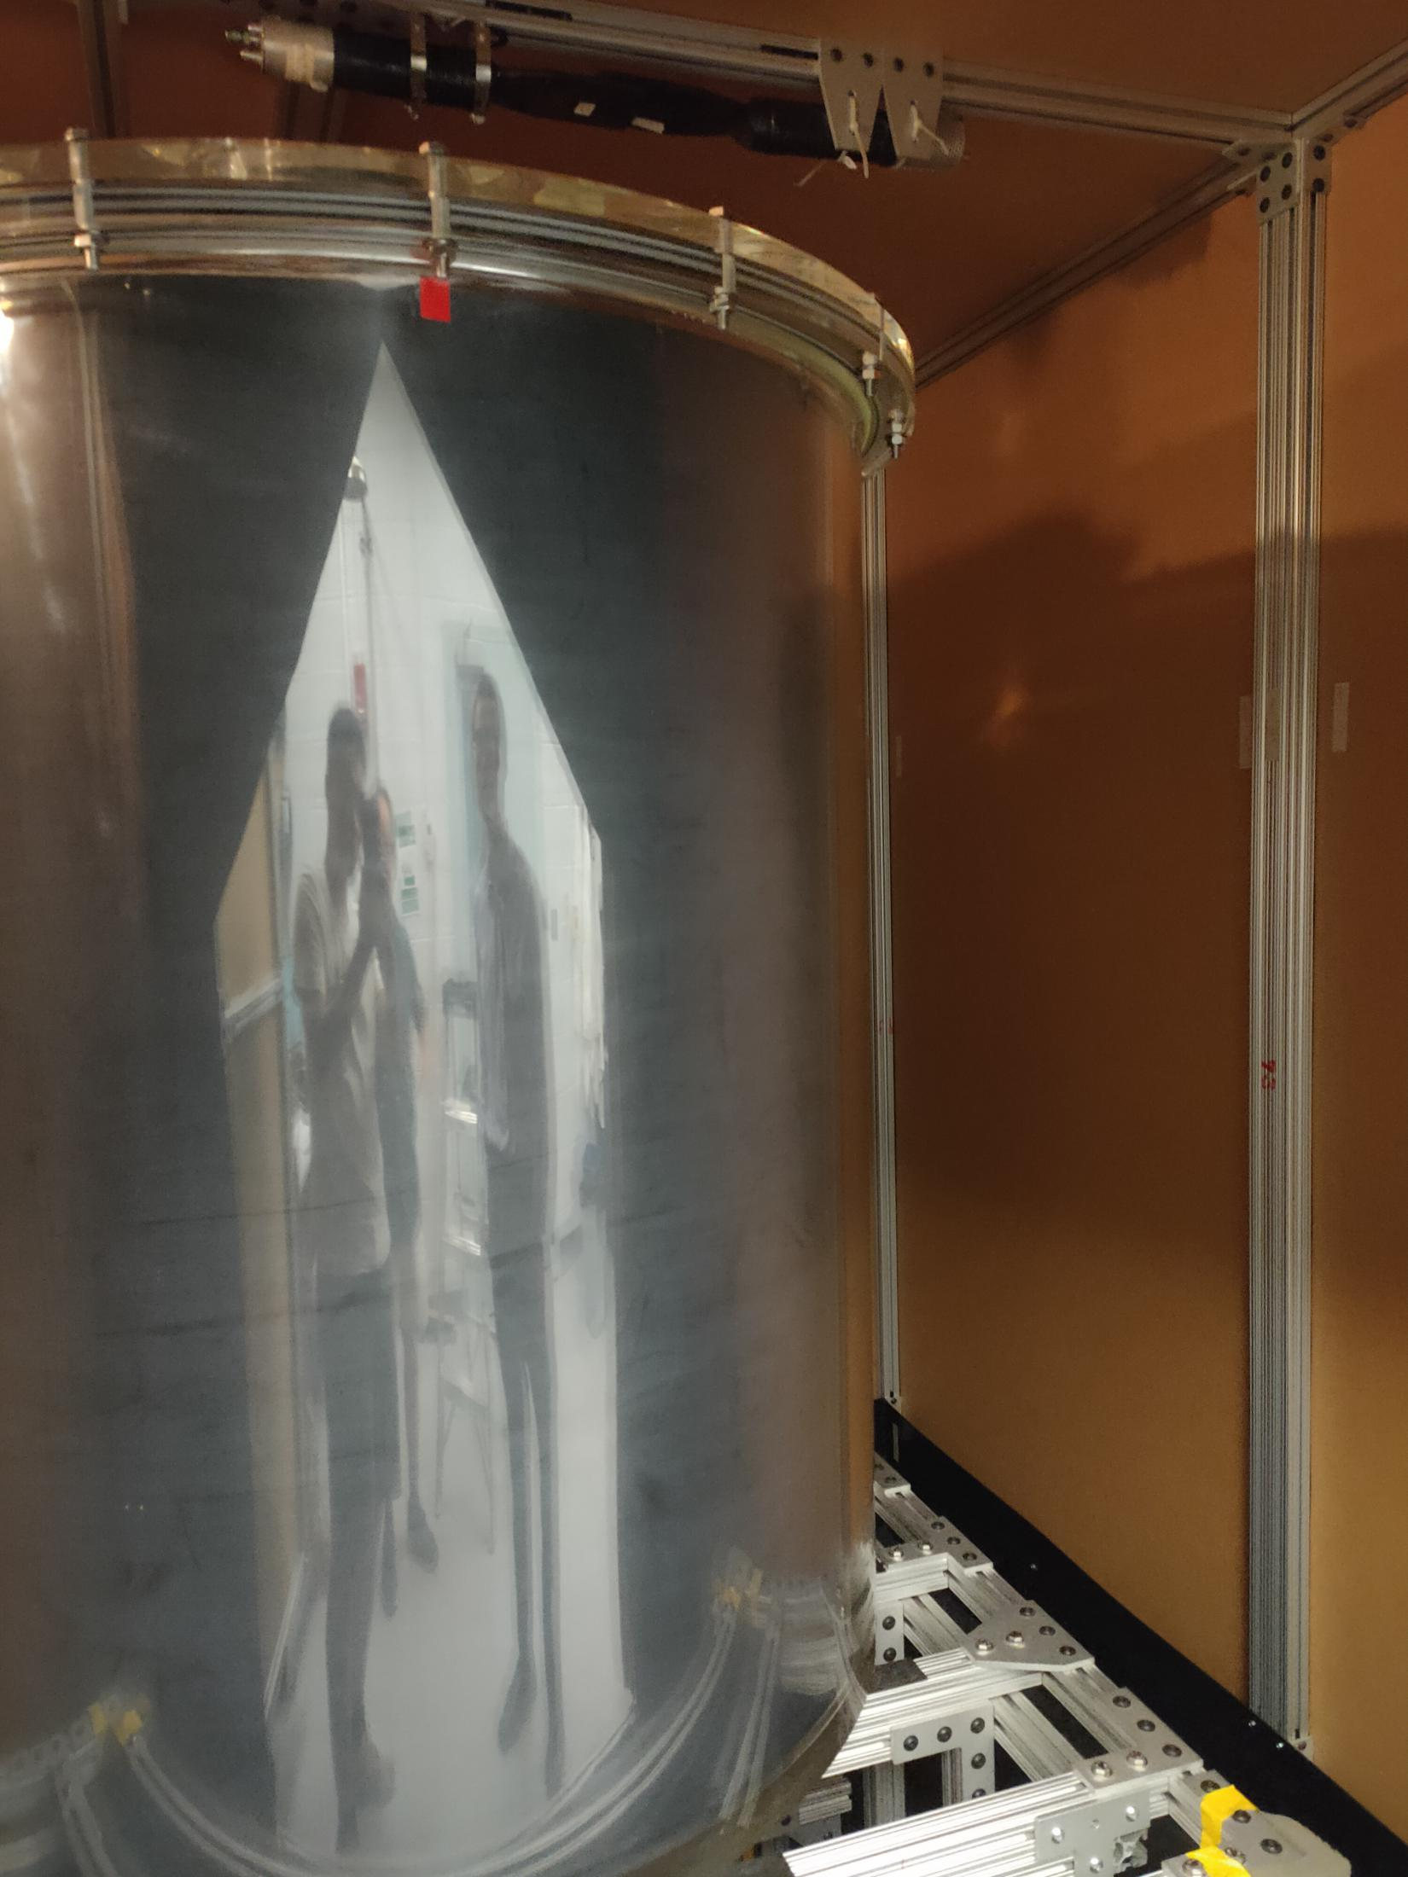
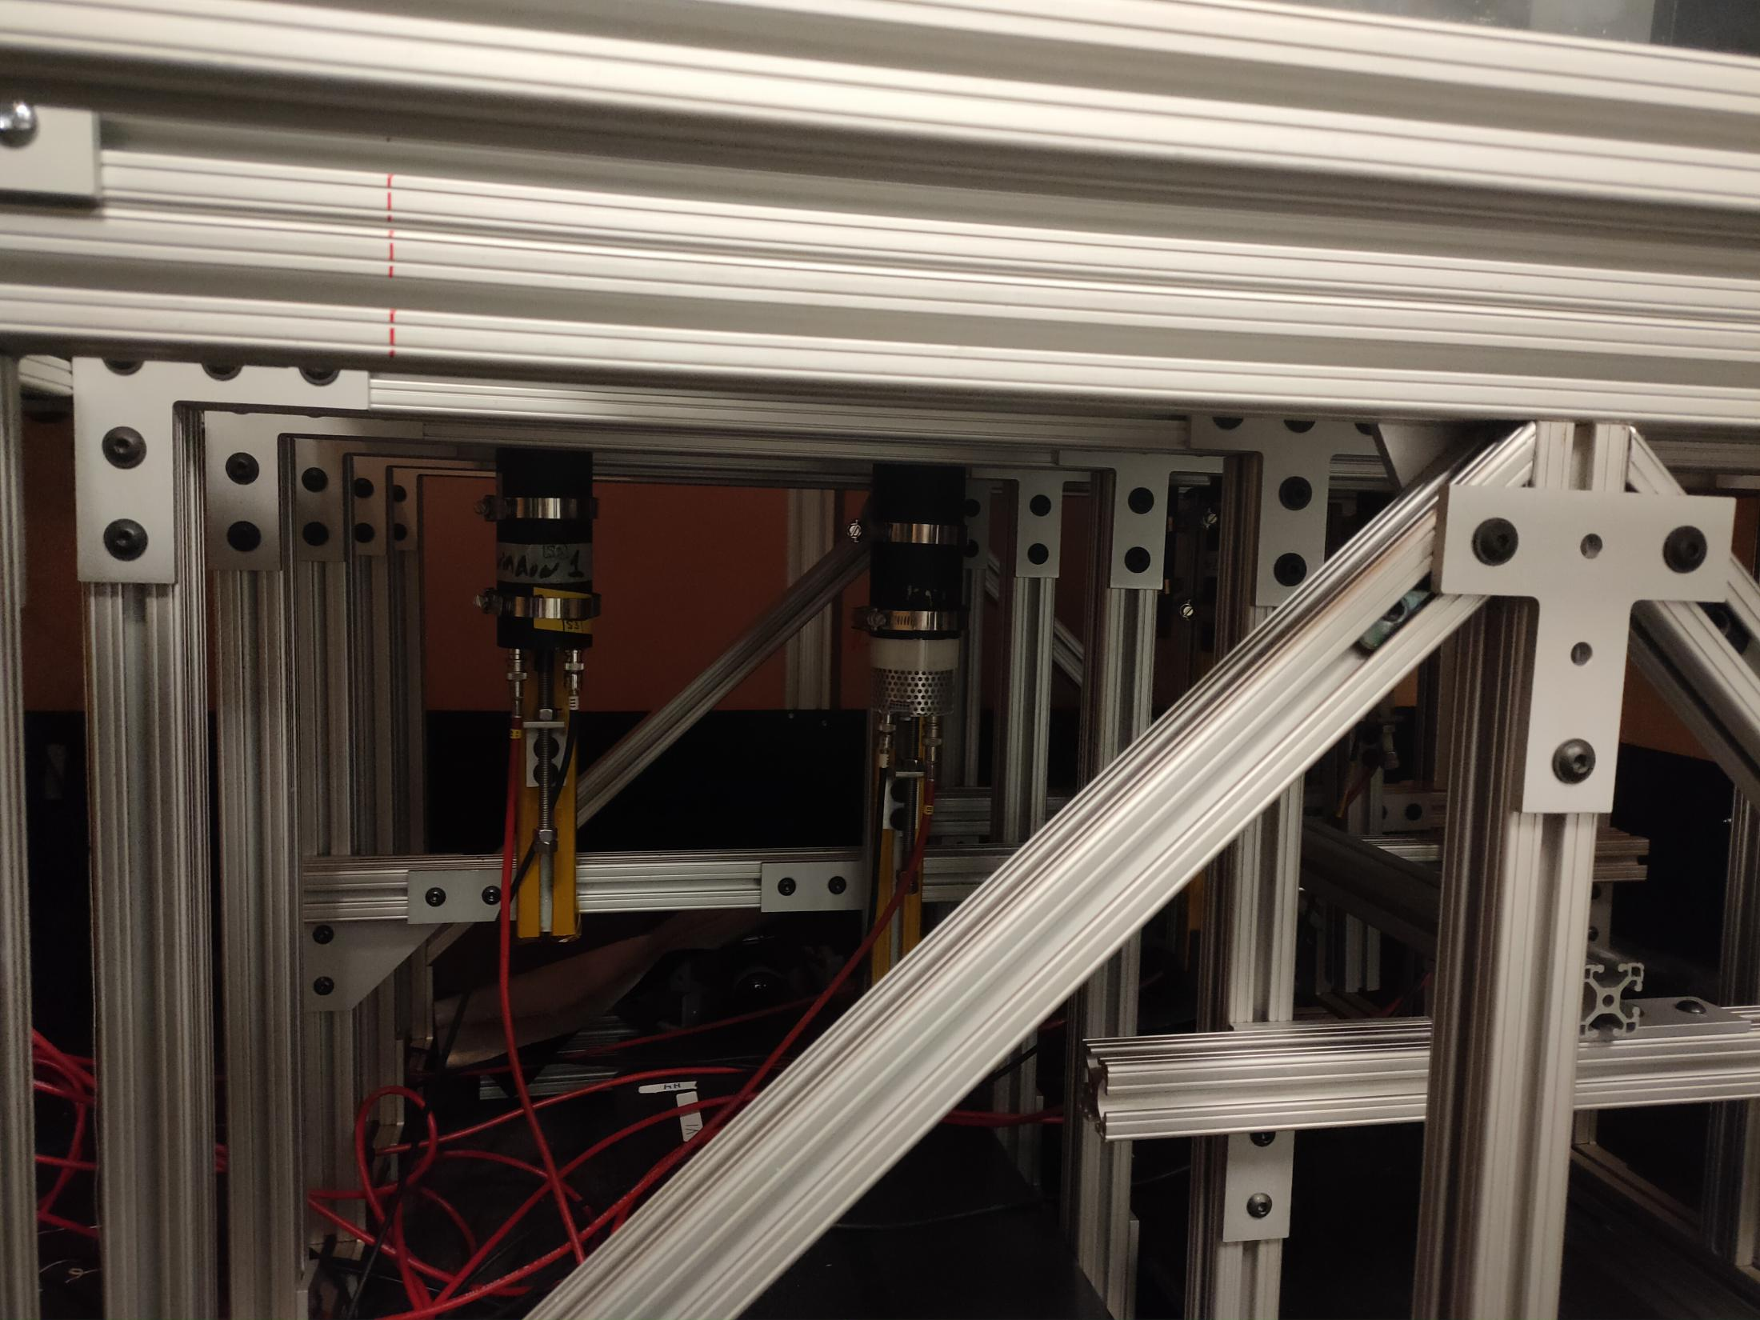

Slide 5
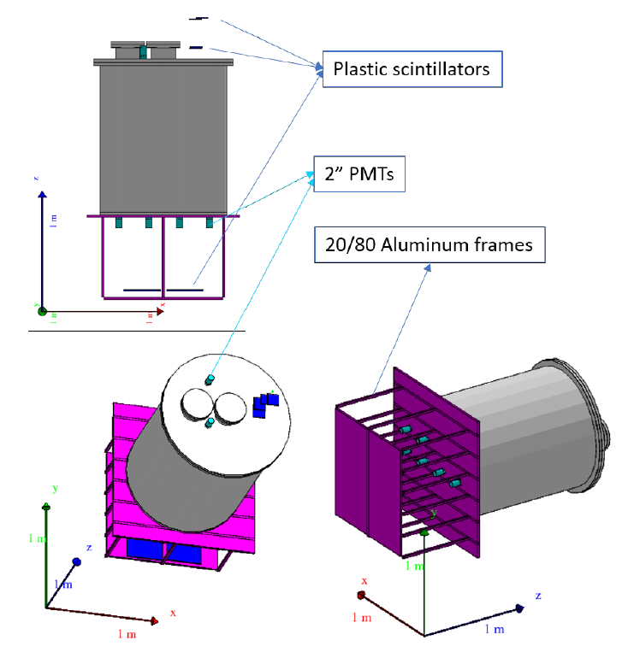
1000 L WbLS – what have been done
Design/build the detector

Slide 6
1000 L WbLS – what have been done
Take data with pure water
from 1/1/2018 to 7/16/2018, obtained ~3.4 M hodoscope triggers
Change the water to WbLS
Take data with the WbLS
From 8/8/2018 to 4/8/2019,
Will focus on ~ two months of data from 8/6/2018 to 10/10/2018, with ~2 M hodoscope triggers
PMT calibration data has also been taken all the time
Simulation part:
Software has been built, using the rat-pac framework (based on Geant4/SNO):
Implemented photon absorption/reemission process;
Muon generator used: the CRY generator.
Other input parameters in simulation:
Materials’ optical properties: refraction index, attenuation length, quantum efficiency, light yield (not for water), absorption/reemission …
Main materials: water, WbLS
Other detector materials include: UVT acrylic vessel, optical cookies, PMTs’ glass and photocathode, black Teflon (for shielding light / stopping reflection at the vessel wall)

Slide 7
Analysis status
Analyzed mostly with water data
Attenuation model in water is built with one parameter,
Established procedure for comparing simulation and data, by evaluating chi-2 value when scanning through the model parameter
Still in the process understanding water’s attenuation…

Slide 8
WaterDATA
detector response
WbLS data
calibration
WATER
WbLS
WbLS Model
MC for WbLS
MC results

Slide 9
acrylic vessel
PMT
optical cookie
muon track

Slide 10
idea for find out water absorption length a
multiplicity trigger data
add the ration to MC
PMT 0,1,2,3 have symetric position in the dector
the ratio of effective DE of [0,3] and [1,2]
for hodoscope, scanning a_{0,3} and find one which minimize the chi^2
scanning a_{1,2} and find one which minimize the chi^2
if a_{0,3} is consistant with a_{1,2}, we get a good value of a
apply the new a value in MC, cablibrate the efective DE for PMTs

